Slide 1
Data-driven business process change proposal to Dognition company management about how to increase the numbers of tests users complete.
Akanchha Choudhary

Slide 2
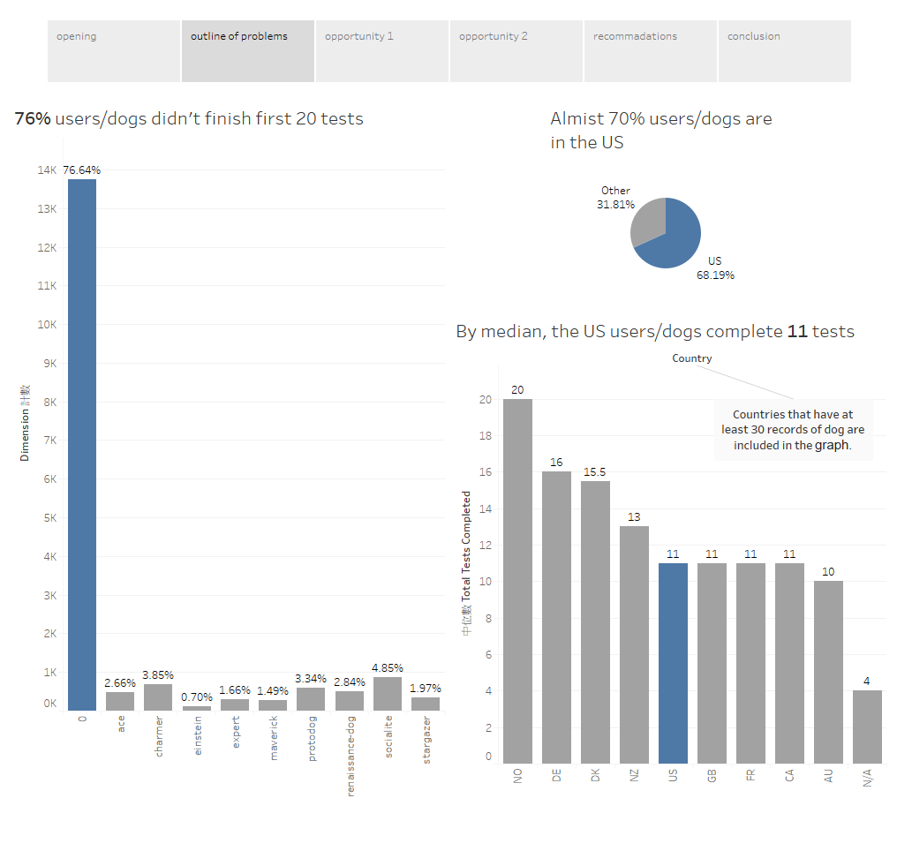

Slide 3
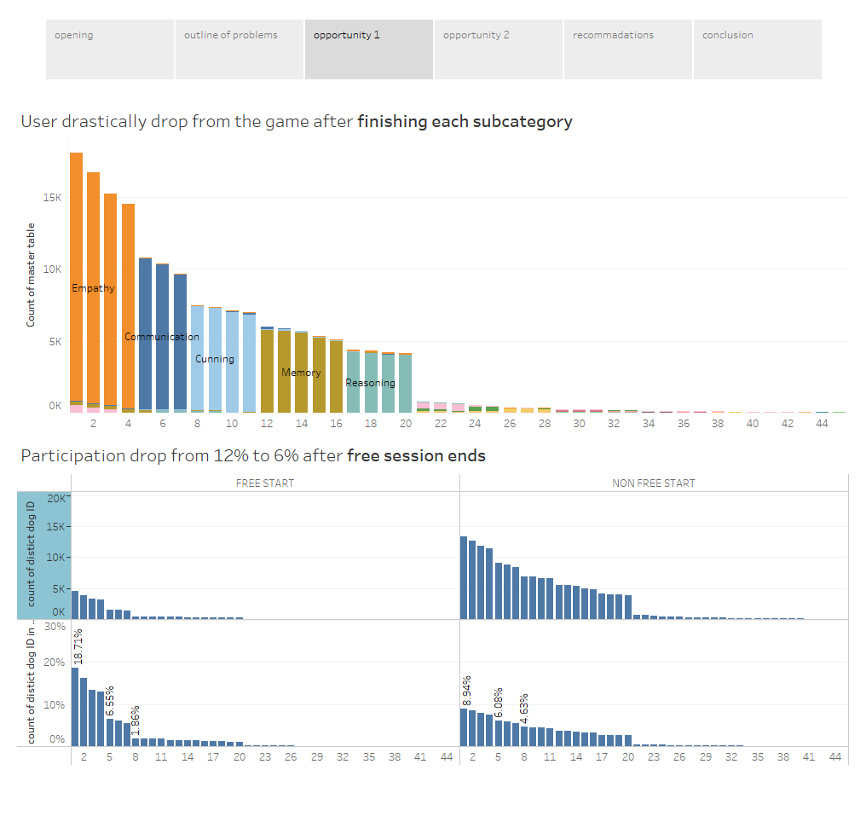

Slide 4
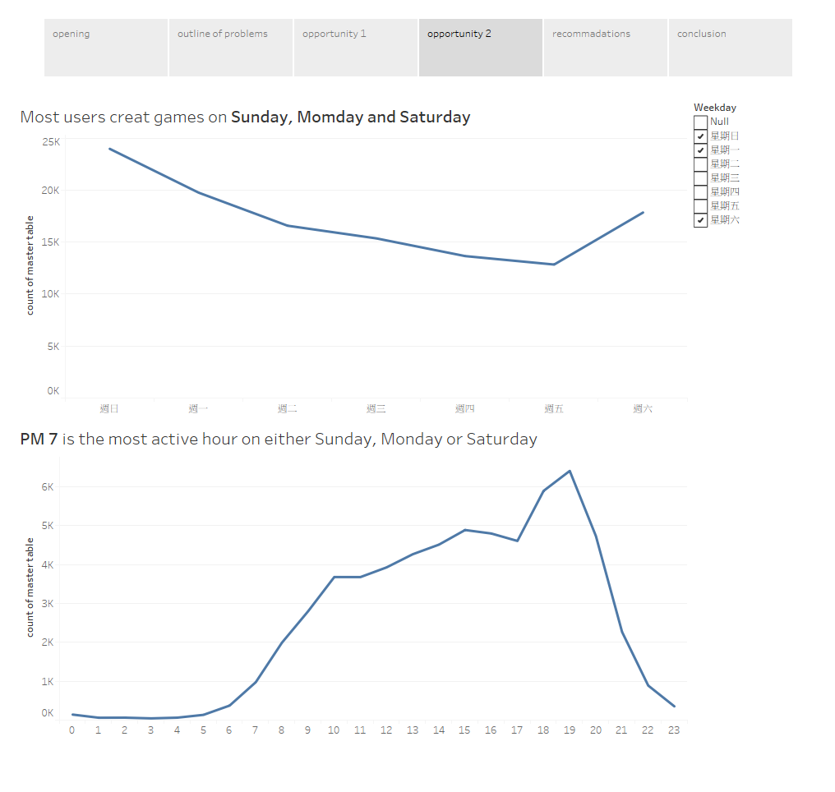

Slide 5
In order to increase more customer for testing:
1.Look into for why free start users drop off later from participating games
2. include 1 test from each subcategory for 4 to 5 games
3. Show small achievment through revealing dog’s personality after few games.
4.reach out for proper advertising source.

